Slide 1
ONLINE SCRAPYARD
GUIDED BY:- TANAJI PATIL

Slide 2
Introduction
Our aim is to develop a web-based E commerce website for buying and selling of scrap materials. The waste materials produced by domestic, industrial, and commercial sectors can be sold on this website. The individual or an organization who has interest on the listed products can purchase that online. After recycling the materials, they can also resell it on the same website.

Slide 3
OBJECTIVE
Platform for scrap sellers and buyers
Online purchasing of scrap materials
Reselling of recycled products

Slide 4
SCOPE
Online buying of scrap
Online selling of scrap
Buying and selling of recycled
products

Slide 5
MODULES
DESIGN
ADMIN
BUYER
SELLER
SEARCH ENGINE

Slide 6
Process logic
INPUT PROCESS OUTPUT
Admin
Scrap material details
Renewed product details
Customer
Buyer and seller profile
Scrap product list
Renewed product
Registration
And Login
Buying and reselling

Slide 7
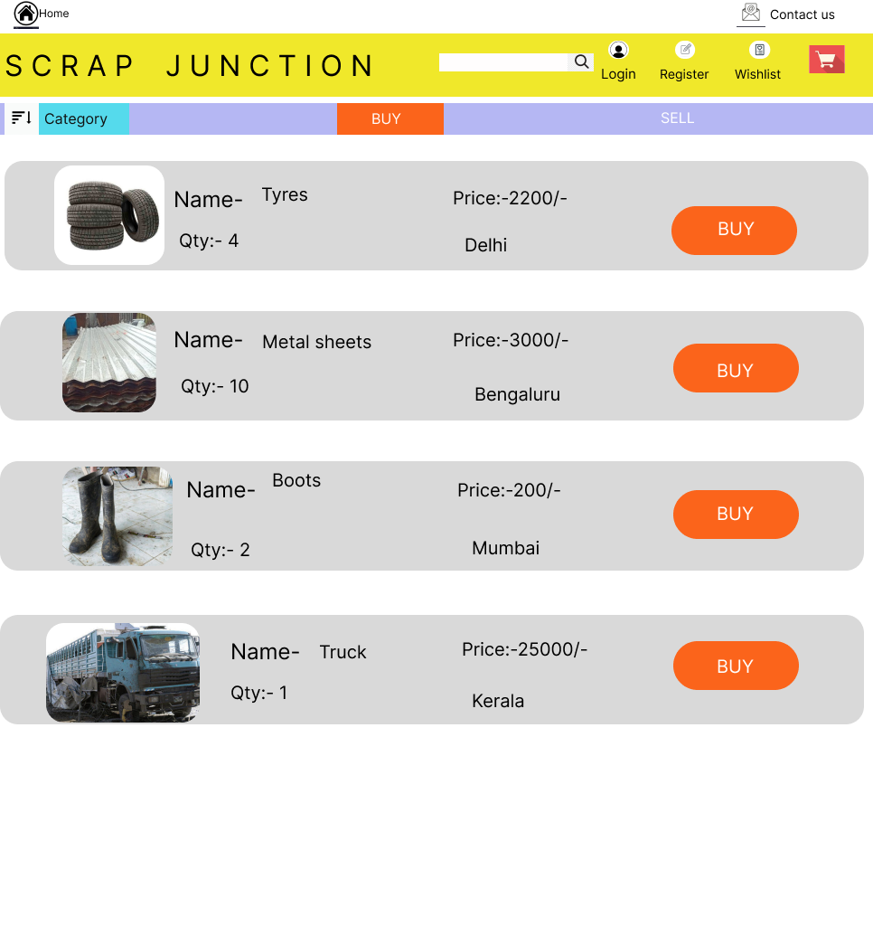
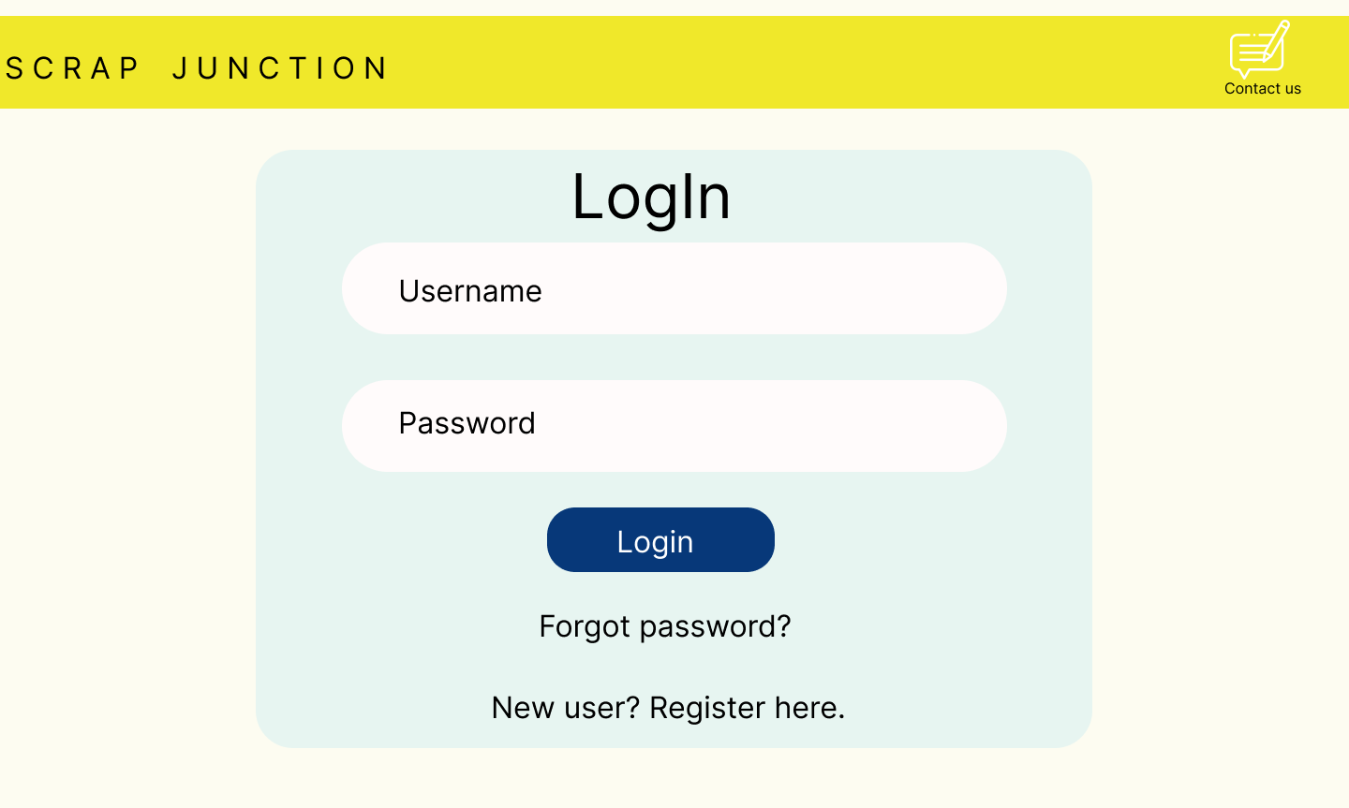
Mock up

Slide 8
Hardware and Software
Requirements
Hardware required for the project:
Processor : Intel -III based system.
RAM : min 512MB
Hard Disk : min 10GB free space.

Slide 9
Software required for the project:
Operating System : Windows 7 or Above
Front End : HTML, CSS, Bootstrap
Back End : JavaScript
Database : Mongo DB

Slide 10
BENEFITS
Time saving
Searching materials made easy
Nearby product/material detection
Easy contact between buyer and seller

Slide 11
LIMITATION
Online delivery option is not available

Slide 12
FUTURE SCOPE
Automatic approval of product request by making android application
Collection of scrap from users if it is unsold

Slide 13
Thank You

